Slide 1

Have you ever wondered how skipping sleep can affect your health and performance ?

Slide 2
The Importance of Sleep
1
What is Sleep?
2
The Stages of Sleep
3
What Happens When You Don't Sleep Enough
4
Tips for Improving Sleep Quality

Slide 3

What is Sleep?
Sleep is a natural state of rest and relaxation . It's a time when our bodies repair and minds to rest . Our brain waves slow down and become more synchronized.

Slide 4

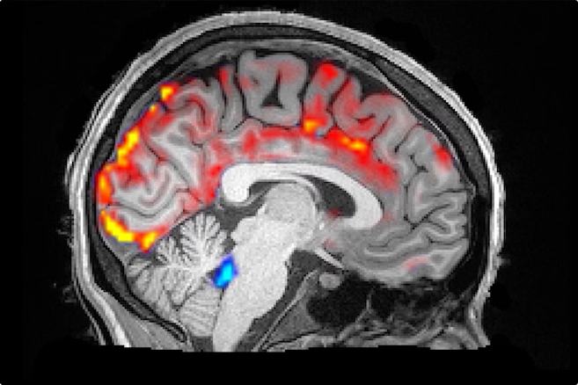
The Stages of Sleep
1
Stage 1
Light sleep, when you're drifting off and waking up. Your brain waves slow down and your muscles relax.
2
Stage 2
Your brain waves slow down even more, and your heart rate and breathing slow down. Your body temperature drops.
3
Stage 3
The deepest stage of sleep, where the body repairs and rebuilds itself.
4
REM Sleep (Rapid Eye Movement)
REM sleep is an active stage of sleep where your eyes move rapidly behind your eyelids. Your brain is active and you can have dreams.

Slide 5




What Happens When You Don't Sleep Enough
Harder to Think Clearly
It's tough to focus, make decisions, and remember things.
More Accidents and Mistakes
Being tired can slow your reactions and make accidents more likely, especially while driving.
Weaker Immune System
Not getting enough sleep can make you more likely to get sick.
Mood Swings and Irritability
You may feel more easily upset or have a hard time controlling your emotions.

Slide 6


Tips for Improving Sleep Quality
Establish a Regular Sleep Schedule
Create a Relaxing Bedtime Routine
Go to bed and wake up around the same time every day
Warm bath, reading, listening to calming music
Optimize Your Sleep Environment
Limit Caffeine and Alcohol
Avoid caffeine and alcohol in the hours before bedtime, as they can interfere with your sleep quality.
Make sure your bedroom is dark, quiet,cool and comfortable .

Slide 7

Getting the Best Sleep
Over the past 4 slides, we've explored:
What is Sleep?
The stages of the sleep cycle
What Happens When You Don't Sleep Enough
Tips for Improving Sleep Quality
In summary
+ Sleep is essential for our physical and mental well-being.
+ taking care of our sleep is important for our health and productivity. Let's apply the strategies we've shared to get deeper, higher-quality sleep.

Slide 8

Thank you

